Slide 2


Data Integration Platform Cloud
Workshop
[Presenter Name]
[Date]

Slide 3
Notes:
This is a Safe Harbor Front slide, one of two Safe Harbor Statement slides included in this template.
One of the Safe Harbor slides must be used if your presentation covers material affected by Oracle’s Revenue Recognition Policy
To learn more about this policy, e-mail: Revrec-americasiebc_us@oracle.com
For internal communication, Safe Harbor Statements are not required. However, there is an applicable disclaimer (Exhibit E) that should be used, found in the Oracle Revenue Recognition Policy for Future Product Communications. Copy and paste this link into a web browser, to find out more information.
http://my.oracle.com/site/fin/gfo/GlobalProcesses/cnt452504.pdf
For all external communications such as press release, roadmaps, PowerPoint presentations, Safe Harbor Statements are required. You can refer to the link mentioned above to find out additional information/disclaimers required depending on your audience.

Slide 4
Program Agenda
1
Introduction
Data Integration Platform Cloud Overview
Data Integration Platform Cloud Deep Dive
Workshop Labs
Wrap up
2
3
4
5

Slide 5

Oracle Cloud Platform
Comprehensive
Open
Integrated
Hybrid
Data Management
Analytics and Big Data
Application Development
Content & Experience
Enterprise Integration
Identity & Security
Oracle Public Cloud
Oracle Cloud at Customer
Data Integration
Systems Management
Oracle Data Center
Your Data Center
Built on High Performant Oracle Cloud Infrastructure
Notes:
Oracle Cloud Platform:
Most Comprehensive Offering, with best of breed solutions for Data Management, AppDev, Enterprise Integration, etc.
Based on Open Standards (HTML5, REST, Kubernetes, oAuth, etc.) and giving you a choice of technology stacks
Providing Seamless Integration among PaaS offerings and across the entire Oracle Cloud Stack (IaaS, PaaS, SaaS)
True Hybrid Cloud – providing you the flexibility of deploying in Oracle’s Public Cloud or in your own data center with Oracle Cloud @ Customer
And leveraging the superior Scalability, Availability and Performance of Oracle’s Cloud Infrastructure

Slide 6
Oracle Cloud Platform Momentum
14,000+
3,000+
$1.4 Billion
10 PaaS
Oracle
Apps in the
FY17 Oracle Cloud
Categories where
Cloud Platform
Oracle Cloud
Platform
Oracle is a
Leader
Revenue
According to
Customers
Marketplace
(60% YoY Growth )
Industry
Analysts
Notes:
Oracle Cloud Platform Momentum:
Over 14k Oracle IaaS and PaaS Customers
In the Oracle Cloud Marketplace: over 3,000 apps and extensions from over 900 partners
For fiscal 2017, Oracle PaaS and IaaS revenues were up 60% to $1.4 billion (Total cloud revenues were up 60% to $4.6 billion.)
Oracle identified as a Leader in 10 major PaaS Analyst Reports (Forrester Waves/Gartner Magic Quadrants)

Slide 7
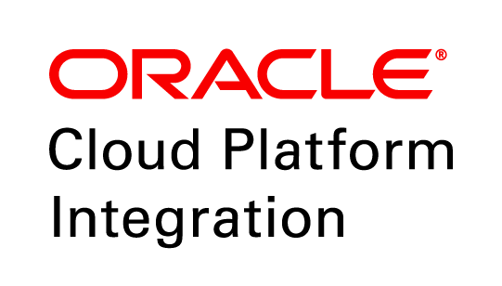


Oracle Cloud Platform for Integration
Application and Data Integration
APPLICATION INTEGRATION
Data
Governance
API
MANAGEMENT
Complete
Data
Quality
Process Automation
Simplified
Stream analytics
Open
Bulk Data Transformation
Real Time Data Streaming and Data Replication

Slide 8
“Computing hardware
Data is the Single Biggest Asset for Most Companies
used to be a capital asset,
while data wasn’t thought
of as an asset in the same
way. Now, hardware is
becoming a service people
buy in real time, and the
lasting asset is the data.”
– Erik Brynjolfsson, Director, MIT Initiative on the Digital Economy
http://www.oracle.com/us/technologies/big-data/rise-of-data-capital-wp-2956272.pdf

Slide 9
average cost of an unplanned data outage at $7,900 a minute, a 41% increase from 2010, when the cost per minute at $5,600.
Typical data outages last 86 minutes, totaling an average of $690,200 of costs.
But Data is Hard for Most Business’
72% of big data projects have issues with data integration reliability
17 month average implementation time for a BI project; 5 months before there is any usable BI artifacts
<32% of BI projects are declared successful
36% confidence rate that the right data is available to the right people at the right time
42% firms managing over $200B in assets do not
have regular processes and procedures to
control data usage
Notes:
https://devops.com/real-cost-downtime/
http://www.networkcomputing.com/networking/high-price-it-downtime/856595126

Slide 10
1. Make Data Always Available – No Outages
Capabilities a Data-Driven Business Needs
2. Get Data to Where it is Needed, at Right Time
3. Access Data in Any Format
4. Govern Data so that it can be Trusted
5. Stream Data so any Business SLA is Covered
Notes:
Everything we create is tethered to the fundamental concept of the platform
What’s a ‘platform’? A platform is a group of technologies that are used as a base upon which other applications, processes, or technologies are developed
A platform enables our customers to move from point products and disconnected services to a fully integrated Cloud platform that transforms business
Developers develop on platforms; enterprises adopt platforms; customers shift to platforms
There’s usage…and there’s adoption
Platforms drive adoption

Slide 11
Data Integration Platform Cloud
Overview
Notes:
This is a Section Header with Picture slide ideal for including a picture with a brief title and optional subtitle. This slide can also be used as a Q and A slide.
To customize this slide with your own picture:
Right-click the slide area and choose Format Background from the pop-up menu. From the Fill menu, click Picture and texture fill. Under Insert from: click File. Locate your new picture and click Insert.
To copy the Customized Background from Another Presentation on PC
Click New Slide from the Home tab's Slides group and select Reuse Slides.
Click Browse in the Reuse Slides panel and select Browse Files. Double-click the PowerPoint presentation that contains the background you wish to copy.
Check Keep Source Formatting and click the slide that contains the background you want.
Click the left-hand slide preview to which you wish to apply the new master layout.
Apply New Layout (Important): Right-click any selected slide, point to Layout, and click the slide containing the desired layout from the layout gallery.
Delete any unwanted slides or duplicates.
To copy the Customized Background from Another Presentation on Mac
Click New Slide from the Home tab's Slides group and select Insert Slides from Other Presentation…
Navigate to the PowerPoint presentation file that contains the background you wish to copy. Double-click or press Insert. This prompts the Slide Finder dialogue box.
Make sure Keep design of original slides is unchecked and click the slide(s) that contains the background you want. Hold Shift key to select multiple slides.
Click the left-hand slide preview to which you wish to apply the new master layout.
Apply New Layout (Important): Click Layout from the Home tab's Slides group, and click the slide containing the desired layout from the layout gallery.
Delete any unwanted slides or duplicates.

Slide 12
Key Capabilities:
1. Data High Availability
Oracle Data Integration Platform Cloud
2. Data Migrations
3. Data Warehouse Automation
4. Databus & Stream Integration
5. Data Governance
Notes:
Everything we create is tethered to the fundamental concept of the platform
What’s a ‘platform’? A platform is a group of technologies that are used as a base upon which other applications, processes, or technologies are developed
A platform enables our customers to move from point products and disconnected services to a fully integrated Cloud platform that transforms business
Developers develop on platforms; enterprises adopt platforms; customers shift to platforms
There’s usage…and there’s adoption
Platforms drive adoption

Slide 13
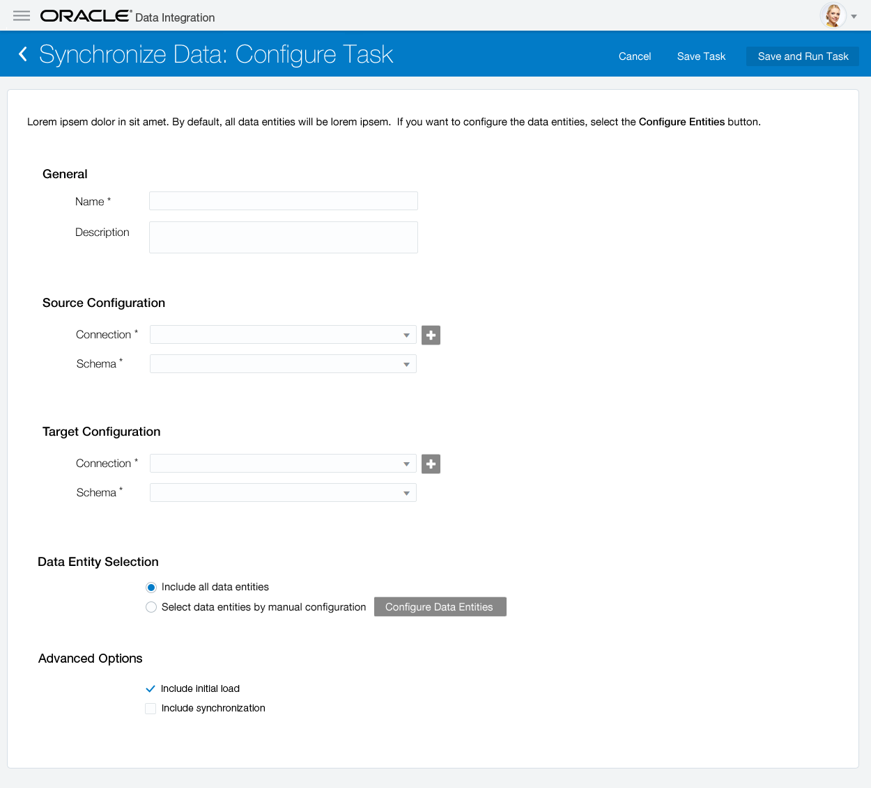
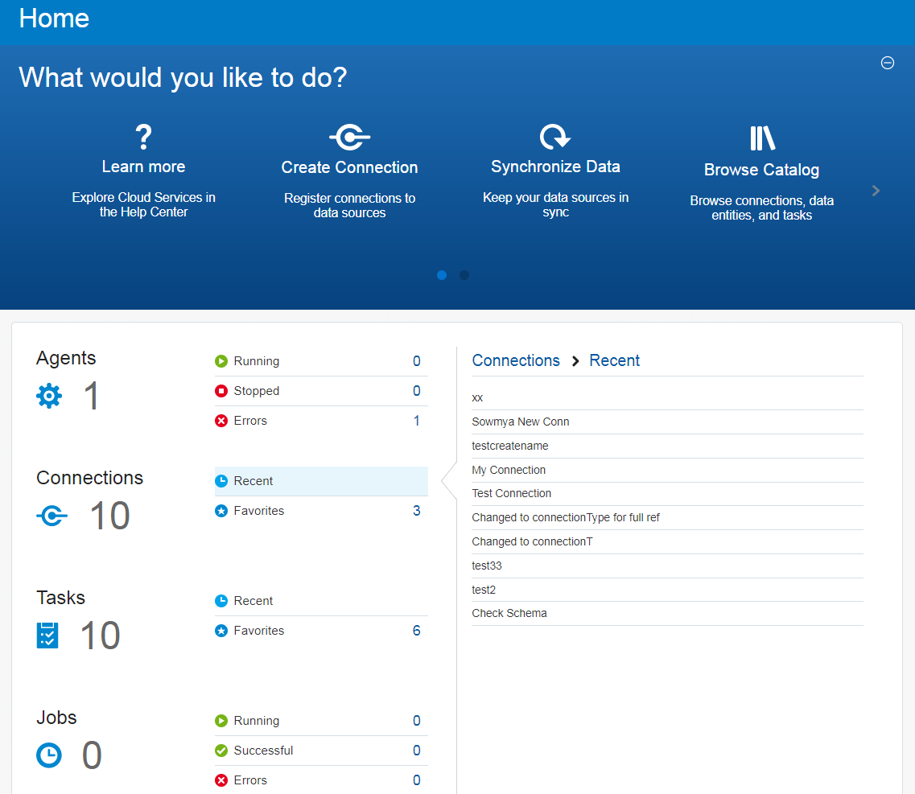

Oracle Data Integration Platform
Integrate, Automate, Govern - Cloud and On Premise Data Lakes and Data Warehouses
…a Unified solution …that’s Easy to use …for Powerful data-driven solutions
Solving These Challenges
Simplify Migrations
Integrate Anywhere – Cloud, On-premises or Hybrid
Prevent Outages
Deliver Trusted Data
Copyright © 2017, Oracle and/or its affiliates. All rights reserved.
13

Slide 14



Comprehensive Data Integration In the Cloud
DBA
& Architects
ETL
Developer
Data
Steward
Ingest
Process
Serve
Prepare
Transform (E-LT & ETL)
Applications / APIs
Event Hubs
Profile & Enrich
Cleanse & Match
Publish & Provision
NoSQL & Graph
Replicate
Data Virtualization
Poly Structured Data Sources
Warehouse / Marts
Unified Connectivity, Data Catalog & Data Governance
PaaS / Platforms (Java, Kafka, Hadoop, Spark, Database etc)
IaaS / Infrastructure (Compute, Storage, Engineered Systems etc.)

Slide 15

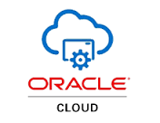
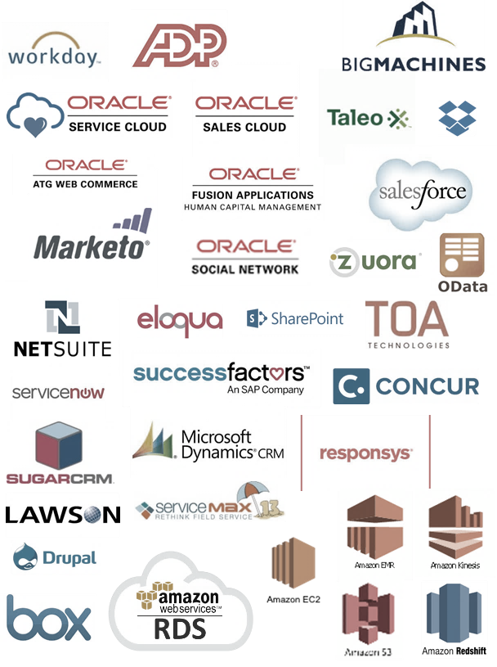
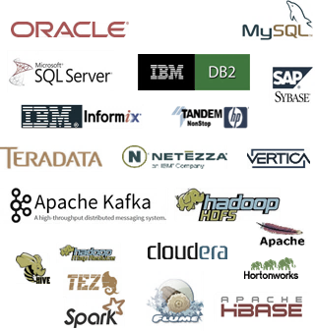


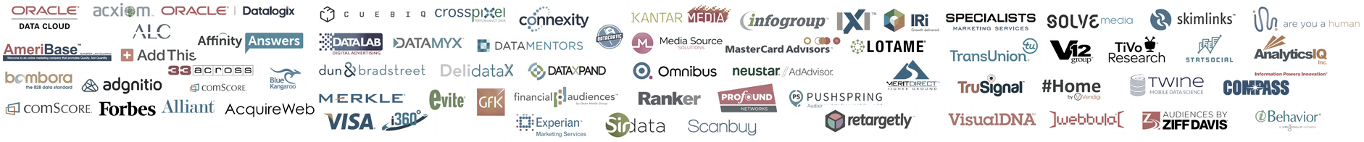
Open Platform
Business Data OLTP/Applications
Oracle Data Integration Platform Cloud
Analytics / OLAP and Serving Layers
Access >125 Sources
Runs on Oracle Cloud
Runs on Premise (cloud machine or remote agent…)
Runs on Amazon (remote agent on any cloud…)
Integrate >100 Targets
3rd Party Data Sets

Slide 16

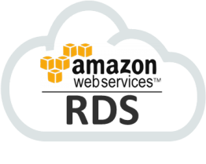





Key Use Cases
EXACS
DBCS & EXACS
DBCS & EXACS
Database Migrations to Cloud
Data Warehouse Integration in the Cloud
High Availability in Cloud
Seamless migration from older databases or obsolete infrastructure
Secure, control, monitor integration infrastructure
Eliminate downtime and reduce unplanned outages

Slide 17
Solving Key Challenges
Oracle Data Integration Platform Cloud
DBA
& Architects (Replicate)
ETL
Developer (Transform)
Data Steward
(Govern)
3 click database migrations from Oracle 11g to 12c
Quickly migrate off of Amazon RDS onto Oracle DBaaS
Point and click multi-active database across Regions
Generate a data mart in minutes without coding
Quickly discover and connect to popular Databases
Leverage hybrid environments
Create a comprehensive catalog of business terms
Quick profile your data for data quality health check
1 click to see end-to-end lineage of data flows

Slide 18
Flexible Packaging
 |  | Data Integration Platform Cloud
Solution Use Cases: | Features: | Standard Edition | Enterprise Edition | Governance Edition
Database Migrations (offline) Bespoke Data Marts DW Automation (batch) Database E-LT & ETL Profiling & Lineage (basic) | Intuitive Web Dashboard & Service Home | ✓ | ✓ | ✓
 | Bulk Data Movement & Transformations | ✓ | ✓ | ✓
 | Basic Profiling with SaaS & PaaS Connectivity | ✓ | ✓ | ✓
 | Admin, Monitoring, Basic Governance | ✓ | ✓ | ✓
Database Continuity Database Migrations (online) DW Automation (stream/batch) Real-time Reporting/Analytics Big Data ETL (stream/batch) | Streaming Database Transactions |  | ✓ | ✓
 | Streaming ETL and Complex Transformations |  | ✓ | ✓
 | Native Big Data (stream/batch) Support |  | ✓ | ✓
 | Multi-Directional Database Replication |  | ✓ | ✓
Data Profiling (advanced) Data Cleansing (real-time/batch) Data Lineage (comprehensive) Audit and Repair, Workflow | Advanced Business Glossary and Business Rules |  |  | ✓
 | Comprehensive Data Profiling & Cleansing |  |  | ✓
 | Compliance, Audit and Case Management |  |  | ✓
 | Data Lineage – Business, Vertical, Horizontal |  |  | ✓

Slide 19
Oracle Data Integration Platform Cloud
Oracle Data Integration Platform Cloud Standard
Oracle Data
Integration Platform Cloud Enterprise
Oracle Data
Integration Platform Cloud Governance
Core Use Cases:
Accelerate Data Warehouses
Automate Data Mart Generation
Simplify Data Migration
Core Capabilities:
Simplified User Experience
Bulk Data Movement
Transformations
Relational Push-down Data Processing
Basic Data Profiling
Core Use Cases:
Standard Edition plus:
Big Data Integration
Data Synchronization
ZDT Migrations
Active-Active
Real-time Data Warehouse
Core Capabilities:
Standard Edition plus:
Big Data ELT & Big Data Streaming
Real-time Replication/Streams
Core Use Cases:
Enterprise Edition plus:
Data Health Check
Enterprise Data Cleansing
Core Capabilities:
Enterprise Edition plus:
Data Profiling & Validation
Match & Merge

Slide 20
DIPC | Core Personas
Database Administrator
Data Warehouse ETL Developer
Data Steward
Manages the administration of an organization's databases, analyzes the organization's database needs, and develops a long-term strategy for data storage. She establishes policies and procedures related to data security, integrity and operational replication of data across databases. Laura also oversees the design, maintenance, and implementation of the systems that manage an internal database. She performs a variety of tasks and leads and directs the work of others. A wide degree of creativity and latitude is expected.
Challenges: Pressure to keep mission-critical apps online DB design by non-relational database programmers “Rationalize” all enterprise data elements Maintain “Systems of Record”
Core Skills / Comfort Zone: Installing and upgrading the DB servers Database modeling, relational, ER modeling Ensuring compliance with database vendor licenses Monitoring and optimizing the performance of the DB Planning for backup and recovery of DB information Maintaining archived data Backing up and restoring databases Generating various reports (ad hoc)
Is responsible for ETL development in the company’s analytical infrastructure and tools, which has mostly been relational databases for the past 20 years. He is experienced with using tools to move and transform the exploding amounts of data and in finding ways to help it cost less to make the data broadly available across various corporate data repositories.
Challenges: Help business make better decisions more quickly by making data more easily accessible Deliver high quality data used for new competitive opportunities, profitability and business efficiency Lower costs of operations around IT led data integration (could be operational ETL or focused on analytic ETL)
Core Skills / Comfort Zone: Relational data modeling, ER modeling, tools such as ERWin and Power Designer SQL and procedural programming (eg; stored procedures) Classic ETL tools such as PowerCenter or DataStage Familiarity with a range of EIM tools such as Data Quality (add-on to ETL) and Metadata Management or Business Glossary tools
Is responsible for the management and fitness of enterprise data assets. Data stewards have a specialist role that incorporates processes, policies, guidelines and responsibilities for administering organizations' entire data access, data quality, and data usage in compliance with policy and/or regulatory obligations.
Challenges: Collaborate with various units of the organizations– must foster positive relationships across IT and the business Advocates change in the organization in order to improve data that is not meeting business targets Works to create greater trust and usage rates across the enterprise of data as a whole embracing data quality and governance
Core Skills / Comfort Zone: Developing and enforcing enterprise data standards Ensuring enterprise data is clearly understood, is fit for purpose, has adequate documentation etc. Understanding business data consumption requirements Business process improvement Familiar w/ strategy planning, process design, project requirements gathering and write up

Slide 21

Oracle Data Integration Platform Cloud is Easy To Use
APPLICATION INTEGRATION
One Platform
For all Integration Needs
Zero Code
Point and Click Experience
Complete
Hybrid Integration Support
Single Pane of Glass
For Monitoring & Management
SELF-SERVICE AUTOMATION
DATA INTEGRATION
Analyze
Operate
Engage
Build
Integrate
Stream integration
Secure
API MGMT. &
Data governance
Bulk data & FILE
TRANSFER
BUSINESS PROCESS

Slide 22
Solutions
Full Data Lifecycle Management
Data Governance
Move a Data Warehouse into the Cloud
Data Catalog and Data Lineage for LoB and IT Users
DW/Mart Automation
Active-Active Databases
Marketing Analytics on Big Data Cloud
Governance of Enterprise Standards
Data High Availability
Multi-Region Cloud Availability (Oracle or Amazon)
Customer 360 from Salesforce or Sales Cloud
Serving Layer for Raw Data Access
Streaming Integration
Database record level sharding
Oracle Database Migrations into 12c
Prepared Data Subscriptions for LoB
Data Migrations
PeopleSoft or Workday into Fusion HCM
Streaming ETL for Data Pipelines
Migrate from Amazon RDS to Oracle Cloud

Slide 23
Solution 1: Heterogeneous & Global Data High Availability
Active-Active Databases
Enable multi-directional transaction replication across two or more databases (Oracle or 3rd party)
Replicate across your data centers, Oracle data centers or even 3rd party cloud data centers
Active-Active Databases
Data High Availability
Multi-Region Cloud Availability (Oracle or Amazon)
Multi-Region High Availability for DBaaS
Database record level sharding
When you need better than 99.95% uptime guarantees across your Database as a Service implementations
Works with your data centers or to empower cross-Region availability across Amazon RDS databases
Enable Oracle Database Sharding
Oracle 12.2 features for Database Sharding
Use Oracle GoldenGate for logical row-level sharding in the Oracle database

Slide 24
Solution 2: Point-and-Click Database Migrations
Database Migrations
Seamless data migration from older databases or poorly optimized Cloud services
Take advantage of newest Oracle DB versions in a simple subscription model
Oracle Database Migrations into 12c
Data Migrations
PeopleSoft or Workday into Fusion HCM
Key Benefits – Online/Offline Migrations
Migrate from Amazon RDS to Oracle Cloud
No data loss for phased / online migrations
Strong automation around provisioning and billing
Reliable and proven core GoldenGate technology
3rd Party Cloud Support
Migrate older Amazon RDS instances to Oracle
Data delivery from on-premise to 3rd party Clouds

Slide 25

Solution 3: Self-Service Data Warehouse Automation
Data Warehouse Integration
Operational or Advanced Analytics in the Cloud requires reliable data feeds
Work with data coming from on-premise data sources or other cloud sources
Move a Data Warehouse into the Cloud
DW/Mart Automation
Marketing Analytics on Big Data Cloud
Key Capabilities: Comprehensive Solution
Customer 360 from Salesforce or Sales Cloud
Prepare and Ingest data in realtime; built in support for replication and streaming ingestion to DW/Marts
Transform and Cleanse data; innovative approach allows workloads to run on different PaaS resources
3rd Party Cloud Support
Supports Amazon RDS databases and Redshift
Big data support with Kinesis and EMR

Slide 26
Solution 4: Very Low Latency Streaming & Integration
Low Latency Data Distribution
Keep transactions flowing continuously
Eliminate need for batch extract on DB sources
Minimize Latency and Impact on sources
Serving Layer for Raw Data Access
Streaming Integration
REST API Subscriptions for LoB
Ingestion into Big Data Cloud (of your choice)
Streaming ETL for Data Pipelines
Continuous streaming of DB Transactions into cloud
Populate Oracle Cloud: Event Hub, Spark, Stream Analytics, or Oracle DBCS
Populate Amazon Cloud: Kinesis, Redshift etc.
Databus (Kappa) Style Architecture
Leverage Apache Kafka Topics for data pub/sub
Stream Database transactions into Databus
Populate “master” topics for canonical views

Slide 27
Solution 5: Data Governance for the Business or IT
Proactive, Trusted Data
Instantaneous data quality insights according to approved business standards and terminology
Clearly traceable data lineage and impact analysis for analytics and reporting
Advanced Profiling and Cleansing
Data Governance
3 Kinds of Data Lineage for LoB and IT Users
Simplified Data Steward Application
Business Catalog and Data Policies
Fully integrated data profiling and analysis
Machine-assisted linkage from data assets to business glossary to business rules to trust metrics
Identify, classify and fix bad data from anywhere
Rich collaboration and change management features
Governance Your Way, for Your Data
Flexible workflows, data classification and ownership
Comprehensive auditing

Slide 28
Data Integration Platform Cloud
Deep Dive
Notes:
This is a Section Header with Picture slide ideal for including a picture with a brief title and optional subtitle. This slide can also be used as a Q and A slide.
To customize this slide with your own picture:
Right-click the slide area and choose Format Background from the pop-up menu. From the Fill menu, click Picture and texture fill. Under Insert from: click File. Locate your new picture and click Insert.
To copy the Customized Background from Another Presentation on PC
Click New Slide from the Home tab's Slides group and select Reuse Slides.
Click Browse in the Reuse Slides panel and select Browse Files. Double-click the PowerPoint presentation that contains the background you wish to copy.
Check Keep Source Formatting and click the slide that contains the background you want.
Click the left-hand slide preview to which you wish to apply the new master layout.
Apply New Layout (Important): Right-click any selected slide, point to Layout, and click the slide containing the desired layout from the layout gallery.
Delete any unwanted slides or duplicates.
To copy the Customized Background from Another Presentation on Mac
Click New Slide from the Home tab's Slides group and select Insert Slides from Other Presentation…
Navigate to the PowerPoint presentation file that contains the background you wish to copy. Double-click or press Insert. This prompts the Slide Finder dialogue box.
Make sure Keep design of original slides is unchecked and click the slide(s) that contains the background you want. Hold Shift key to select multiple slides.
Click the left-hand slide preview to which you wish to apply the new master layout.
Apply New Layout (Important): Click Layout from the Home tab's Slides group, and click the slide containing the desired layout from the layout gallery.
Delete any unwanted slides or duplicates.

Slide 29


DIPC Architecture
New DIPC Components
DIPC Console (web app)
DIPC Agent (local Agent in DIPC)
DIPC Remote Agent (can be installed anywhere) for remote access
DIPC metadata stored in DBCS along with ODI and EDQ repositories
Full access to EDQ, ODI and OGG
Data Integration Platform Host
DIPC Console
DIPC Agent
GG
ODI
EDQ
Database CS
OPC - External Compute
DIPC Remote Agent

Slide 30


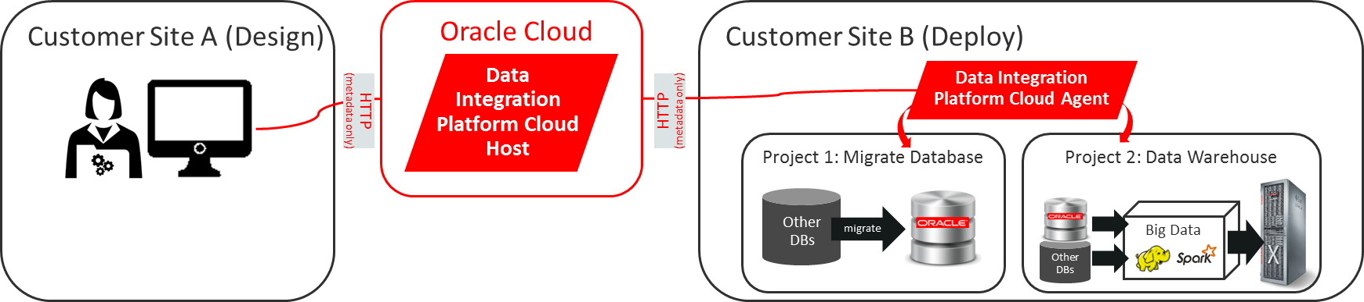

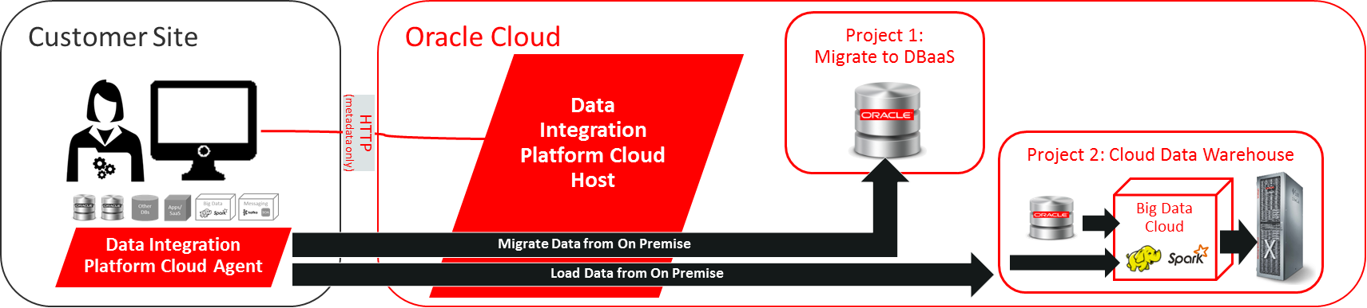





Modular Footprint
Customer Site
Example #1: On Premise Integration
Oracle Cloud
Data Integration Platform Host
HTTP (metadata only)
SaaS / PaaS / DaaS
Studio App
Platform Services
REST Data
HTTP (metadata only)
Any Data
Example #2: Oracle Cloud Integration
Any Data Center (Customer On-Premise or 3rd Party PaaS)
Data Integration Platform Agent
Other DBs
Apps/SaaS
Big Data
Messaging

Slide 31
DIPC with Database Cloud Services
Database CS
Certified with EDQ, ODI and GG
Exadata CS
Certified with EDQ, ODI and GG
Schema Cloud Service
ODI: Certified using REST or BICS connectivity
Database CS
Data Integration Platform Host
GG
ODI
EDQ
Exadata CS
Schema CS

Slide 32

DIPCS with Big Data Cloud Services
Big Data CS
OGG is certified with Hive, HDFS, HBase, Kafka, Cassandra, ElasticSearch etc.
ODI is certified with Hive, HDFS, Spark, Spark Streaming, Cassandra, Kafka etc.
EDQ is certified with Hive
Big Data CS – Compute Edition
OGG is planned to be certified with Event Hub CS. OGG is certified with Hortonworks Data Platform (HDP)
ODI is certified with HDP which is used in BDCS-CE
Note: An ODI Agent cannot be deployed on BDCS or BDCS-CE at this time which limits the integration options
Big Data CS
Data Integration Platform Host
GG
ODI
EDQ
Big Data CS Compute Edition

Slide 33







DIPC with SaaS
OPC
Salesforce.com
Certified with ODI
Other Apps
Use REST connectivity or utilities, if they exist, in ODI
Position partner-provided connectivity as needed
Progress DataDirect: link
Bristlecone: link
Data Integration Platform Host
GG
ODI
EDQ
REST/SOAP /Utilities
SaaS Apps

Slide 34
DIPC with On-Premises Systems & 3rd Party IaaS/PaaS
OPC
Direct access to on-premises systems requires a VPN connection between OPC and the on-premises data center
Without VPN consider the following options
Use one of our DI product on-premises to send the data to a Cloud Service such as DBCS. This requires licensing the on-prem product(s)
Use some manual processes to create files and upload them to a Cloud Service so DIPC can pick them up
Data Integration Platform Host
GG
ODI
EDQ
VPN
Any Data Center (Customer On-Premise or 3rd Party IaaS/PaaS)
Apps/SaaS
Big Data
Messaging
Other DBs

Slide 35



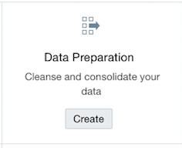
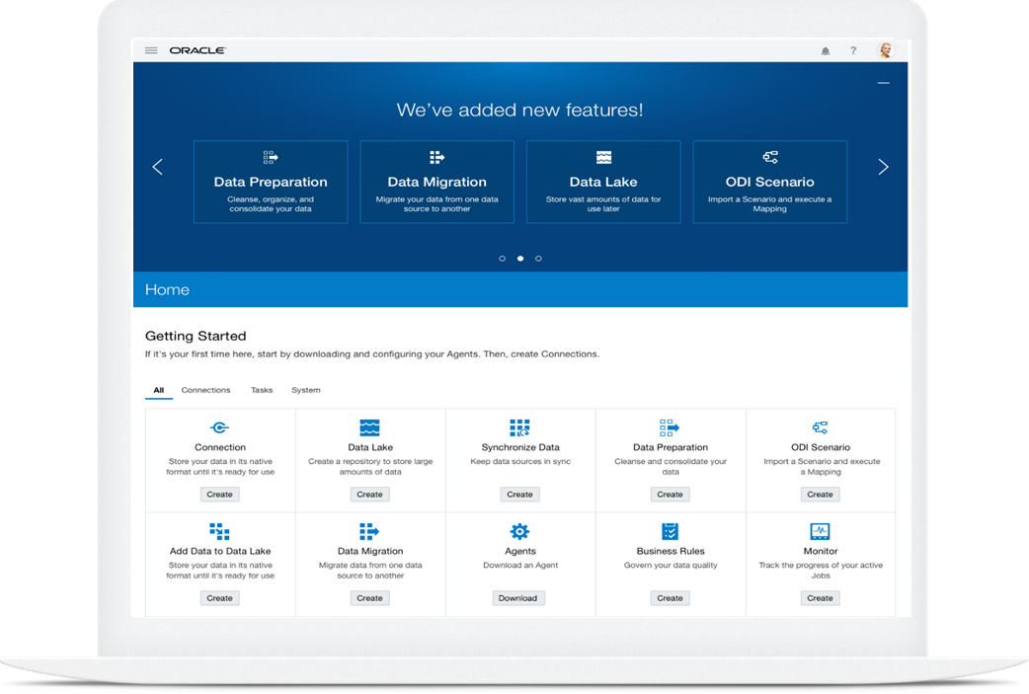
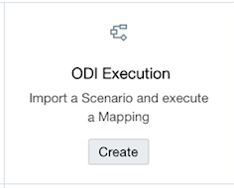
Elevated Tasks
Data Platform
On Ramp
Data Preparation
Ingest and harvest metadata for data wrangling
ODI Execution
Execute ODI scenarios!
Synchronize Data
Major enhancements added in 18.2.3
Notes:
18.2.3 is slated for Cloud uptake in May. (5/4)

Slide 36
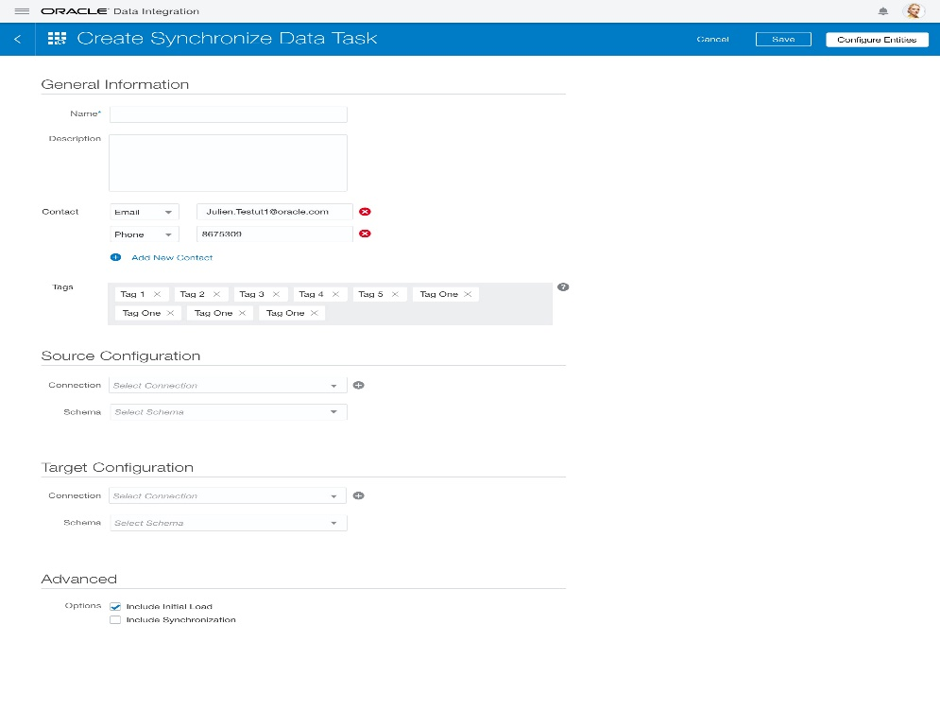
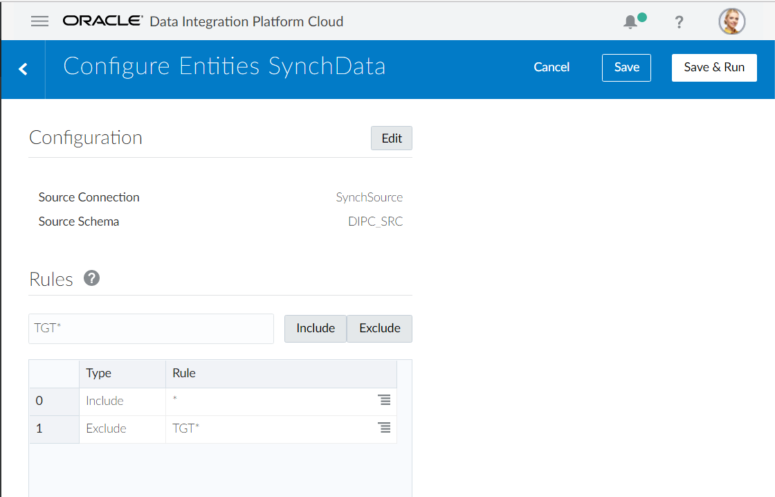
Synchronize Data Task
Data Migrations
Synchronize Data Task
More Control
Initial load
AND/OR On-going synchronization
Data Entity selection using Include/Exclude Rules to only move specific DB objects
Synchronize Data Jobs can be stopped and restarted
Uses GoldenGate Pump and now supports 2 Agents

Slide 37
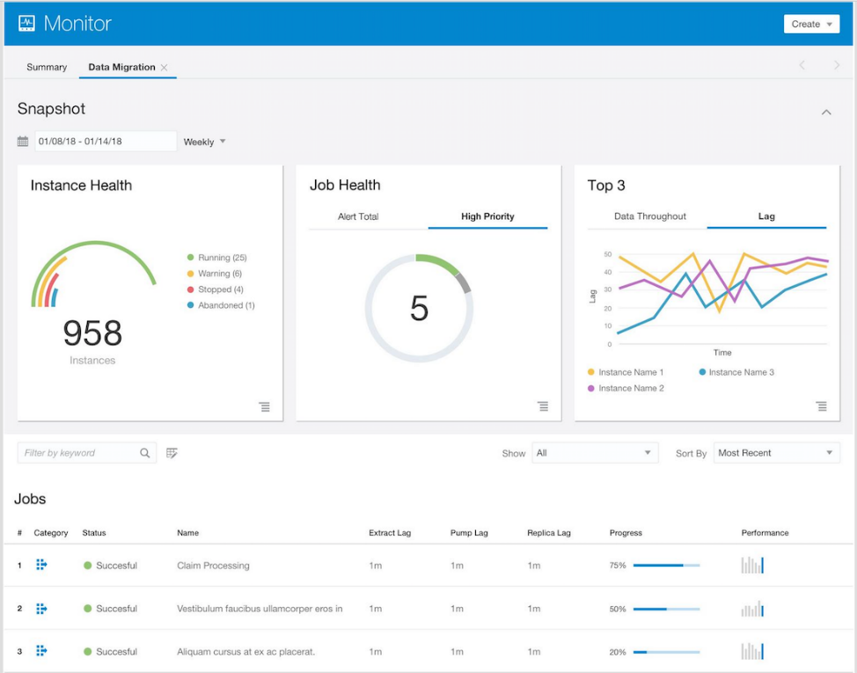
Synchronize Data Task
Data Migrations
Synchronize Data Task
More Control
Initial load
AND/OR On-going synchronization
Data Entity selection using Include/Exclude Rules to only move specific DB objects
Synchronize Data Jobs can be stopped and restarted
Uses GoldenGate Pump and now supports 2 Agents
Monitoring
Monitor Page for Sync Data Jobs
Displays lag and throughput

Slide 38
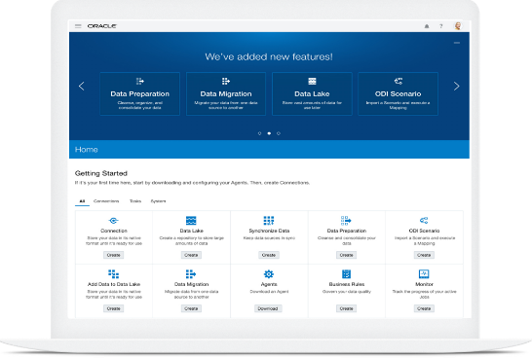
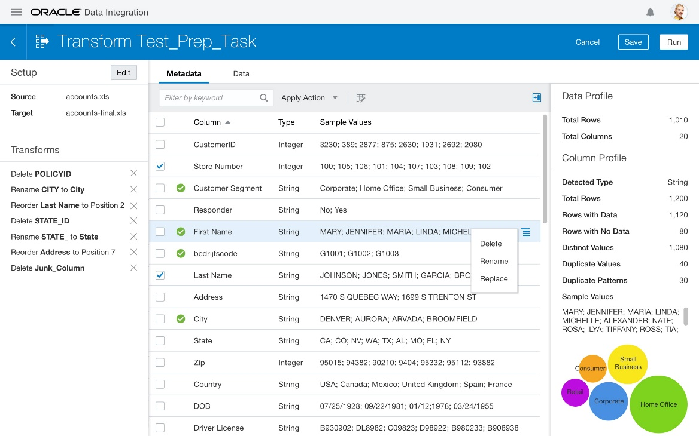
Data Preparation Task
Data Platform
On Ramp
Data Preparation
Easily ingest and harvest metadata for easy data wrangling
Integrated Data Profiling
Data immersive data preparation
Built-in data transformations
Supported Sources/Targets
Oracle Object Storage Classic
Oracle Databases
Flat files
Enabled with Remote Agent
Generates batch ETL process for data preparation

Slide 39
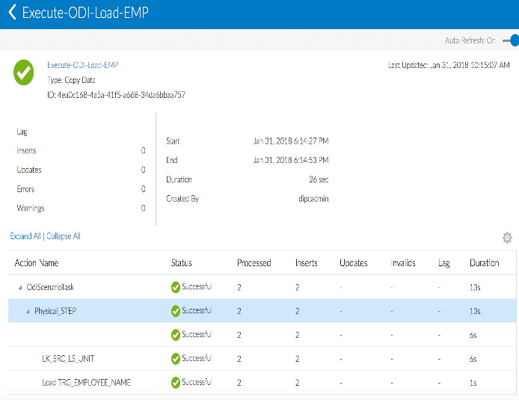
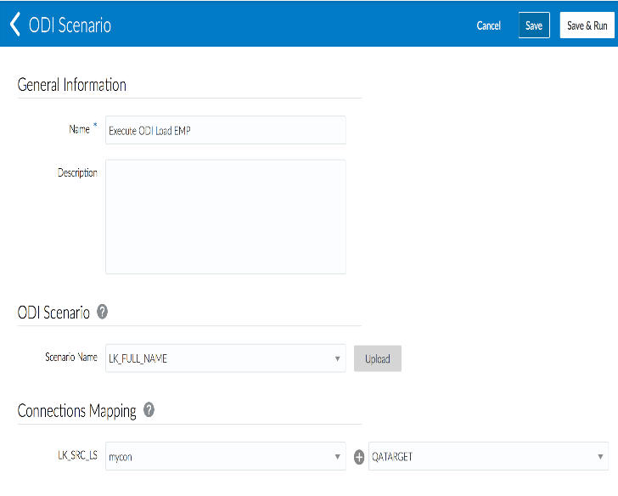
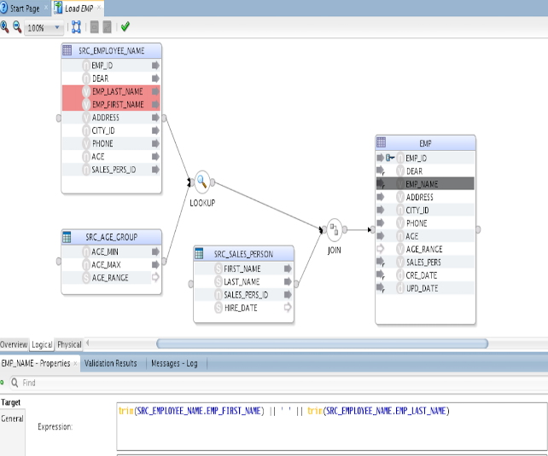
ODI Execution Task
Data Platform
On Ramp
ODI Execution
Easily Execute and Monitor ODI scenario!
Support hybrid development mode
Develop / design on-prem
Import to Data Integration Platform and integrate with DIPC Tasks
Execute and monitor ODI Job in DIPC Console
Supports Technologies currently supported in DIPC

Slide 40
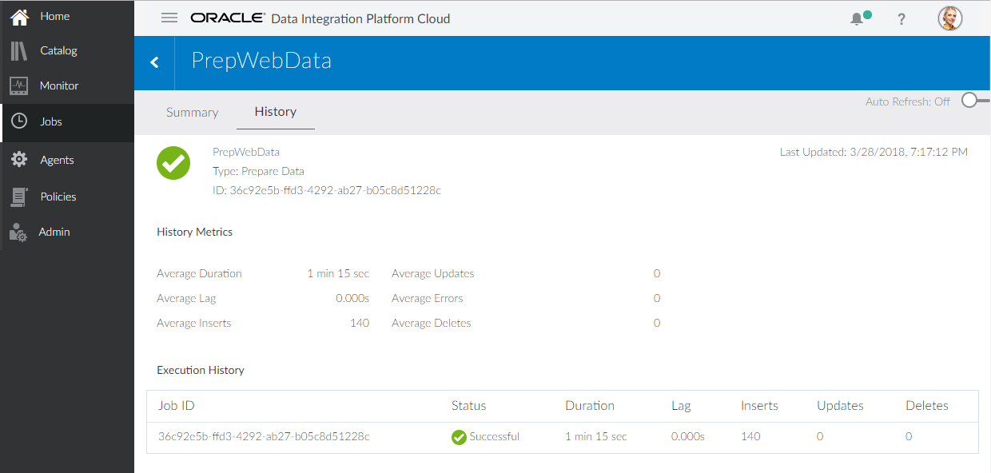
Monitoring
New Job History Page tracks historical metrics for every run of the same Task
Average Inserts Number
Average Updates Number
Average Errors Number
Average Duration
Ability to Stop Jobs

Slide 41
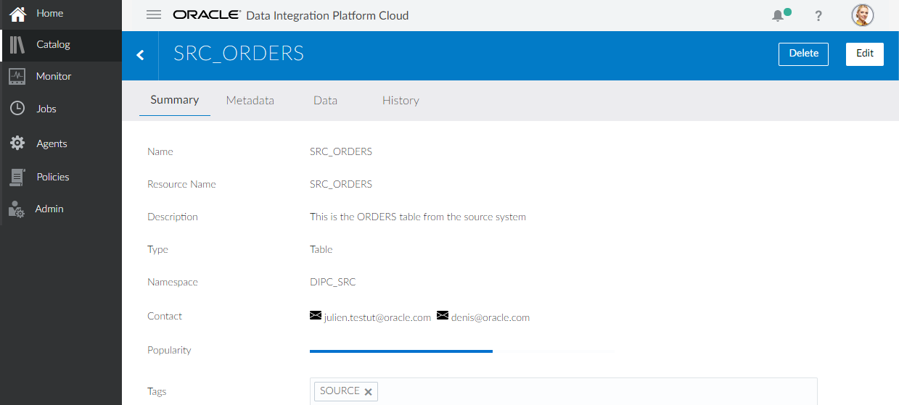
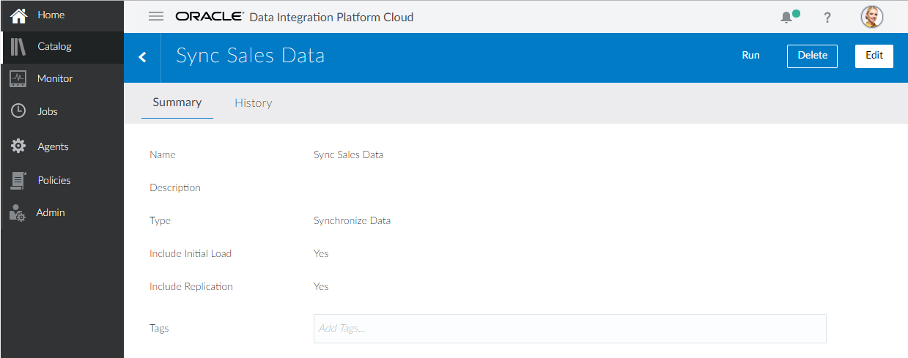
Catalog
Data Entities
Add Contacts
Editor Updates
Connections
New Metadata tab lists all Data Entities related to Connection
New Actions from Details page
Run for Tasks
Delete for all objects

Slide 42
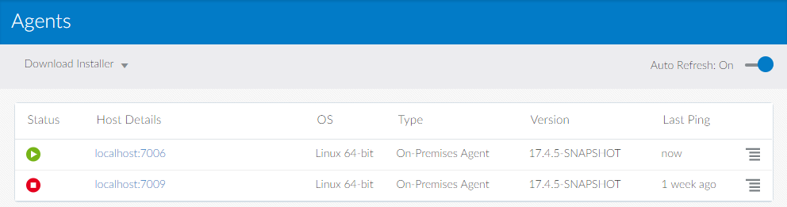
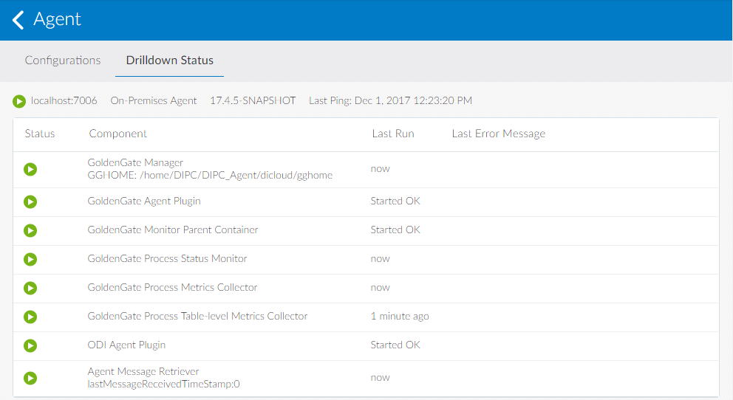
Agents
Supported on Linux
Includes OGG 12.3 binaries
Monitor in DIPC Console
Requires VPN connection in most cases

Slide 43



Needs for On-Premises Agent Integration
OPC
Autonomous Data Warehouse
Database CS
Exadata CS
Data Integration Platform Cloud
Big Data Cloud
Object Storage
TCP/FTP
Results via TCP
TCP
TCP
TCP
Oracle Data Integration On-Premises Agent(s)
Change Data
Bulk Data
SQL Access
Messages

Slide 44
DIPC Agent High Level Architecture
DIPC Server
Configuration Management
Monitoring
Scheduler * Auto Upgrade *
High Availability and Fail Over *
Security & Access Authorizations *
Data Sync
Data Migrations
DIPC Agent
Command and Control
Data Lake Automation
DIPC Agent Mediator Service
DIPC Agent Message Processor
ODI Plug-in*
OGG Plug-in
Veridata
Plug-in*
Metadata Plug-in*
Other Plug-ins…*
VPN
SOCKS HTTPS*
Streaming Integration
OGG Binaries
ODI Agent Binaries*
Veridata Agent
Binaries*
Metadata Binaries*
Other Binaries……
Data High Availability
Source/Target
Legend
* Roadmap item, not available in 18.2.3

Slide 45


Remote Agents Supported Integration Patterns for Data Synchronization & Replication
DIPC Integration Tasks
DIPC Custom Replications
Oracle On-Prem to Cloud Integration – Synchronize Data
Oracle On-Prem to Cloud – Custom DIPC Replication
Customer Site
Oracle Cloud
Customer Site
Oracle Cloud
On-Prem Data Center
On-Prem Data Center
Data Integration Platform Cloud Host
Oracle DB Cloud Service
Data Integration Platform Cloud Host
Oracle DB Cloud Service
DIPC Remote Agent
DIPC Remote Agent
Synchronize Data
Custom DIPC Replication
VPN
VPN
Oracle On-Prem to On-Prem Integration – Synchronize Data
Oracle On-Prem to On-Prem – Custom DIPC Replication
Customer Site
Oracle Cloud
Customer Site
Oracle Cloud
On-Prem Data Center
On-Prem Data Center(s)
DIPC Remote Agent
VPN
Data Integration Platform Cloud Host
Oracle DB Cloud Service
Data Integration Platform Cloud Host
Oracle DB Cloud Service
DIPC Agent
DIPC Agent
Synchronize Data
Custom DIPC Replication
VPN
Data Transfer
Internal DIPC Communication

Slide 46
Remote Agents Custom Replication Processes
DIPC Custom Replications
Oracle On-Prem to Cloud – Custom DIPC Replication
On-prem DIPC Remote Agent (available on Linux only at this time) is required
Customers must download and install DIPC Remote Agents to the appropriate source/target locations
A VPN connection between the DIPC Remote Agent and Oracle Cloud is required (Use SOCKS5 as an alternative)
DIPC Remote Agent support is currently limited to Oracle to Oracle
OGG artifacts (extract, data pump and replicat) must be created directly from within the on-prem DIPC Remote Agents
Connections must be defined within the DIPC Catalog for the replication source and targets
DIPC instance in Oracle Cloud must be running when processes are being executed (billing requirement)
Note that the DIPC Application in Oracle Cloud is not aware of any of these custom artifacts, they are monitored outside of DIPC. Future releases will add support for monitoring these custom processes within DIPC.
Customer Site
Oracle Cloud
On-Prem Data Center
Data Integration Platform Cloud Host
Oracle DB Cloud Service
DIPC Remote Agent
Custom DIPC Replication
VPN
Oracle On-Prem to On-Prem – Custom DIPC Replication
Customer Site
Oracle Cloud
On-Prem Data Center(s)
Data Integration Platform Cloud Host
Oracle DB Cloud Service
DIPC Agent
DIPC Agent
Custom DIPC Replication
VPN
Data Transfer
Internal DIPC Communication

Slide 47
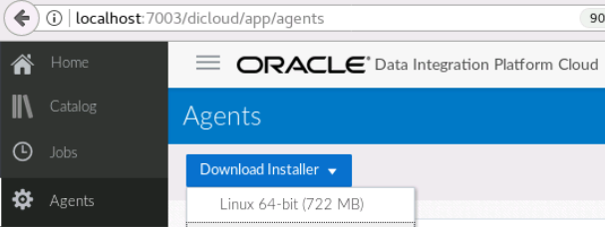
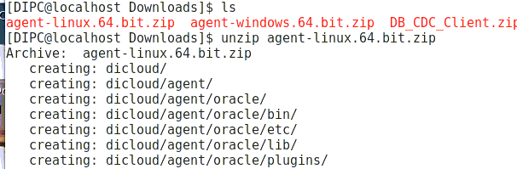
Step 1: Download and Install DIPC Agent

Slide 48
Step 2: Configure On-Premises Agent
Command> cd [Agent_unzip_dir]/dicloud dicloudConfigureAgent.bat (on Windows ) or dicloudConfigureAgent.sh (on Unix)
Basic AuthType: For Local testing/Ravello/ (Note: Cannot be used in IDCS based Oracle Cloud ) Command> ./dicloudConfigureAgent.sh [agent_name] -dipchost=[dipc.example.host.com] -dipcport=[port_no] -user=[diuser] -password=[dipassword] -authType=BASIC eg: dicloudConfigureAgent.bat dipcagent001 -recreate -dipchost=135.169.165.107 -dipcport=9073 -user=weblogic -password=password123 -authType=BASIC
OAuth Type: For IDCS based authentication Command> ./dicloudConfigureAgent.sh [agentInstanceDirectory] -recreate -debug -dipchost=[dipc.example.host.com] -dipcport=[port] -user=[diuser] -password=[dipassword] -authType=[BASIC/OAUTH2] -idcsServerUrl=[idcs_server url] -agentIdcsScope=[agent_IDCS_Client_Scope] -agentClientId=[Agent_IDCS_clientID] -agentClientSecret=[Agent_IDCS_clientSecret] Eg: ./dicloudConfigureAgent.sh -dipchost=dipcsfungerc4-dipcsv2meteri01.uscom-central-1.c9dev1.oc9qadev.com -dipcport=443 -idcsServerUrl=https://idcs-b8bdf957678a4d91b80801964c406828.identity.c9dev1.oc9qadev.com -agentIdcsScope=https://235C1F73C5B54068A7C02A202D6B2B42.uscom-central-1.c9dev1.oc9qadev.com:443external -user=firstname.lastname@ORACLE.COM -password=Password123# -agentClientId=fb035f53b22a450982ec22551cccfdd6 -agentClientSecret=62eda7dc-1991-47ca-8205-fde062c62ab8

Slide 49
Step 3: Start Agent
Directory Command> cd [AGENT_UNZIP_LOC_DIR]/dicloud/agent/[agent_name]/bin/
Start DIPC Agent: Command> ./startAgentInstance.sh (or.bat)
Stop DIPC Agent (for any maintenance) Command> ./stopAgentInstance.sh (or.bat)

Slide 50
References
Setting Up Agent Documentation https://docs.oracle.com/en/cloud/paas/data-integration-platform-cloud/using/setting-agent.html#GUID-1E5C6E1E-F180-4D79-84F2-0EA97C934F2E
DIPC Certification Matrix https://docs.oracle.com/en/cloud/paas/data-integration-platform-cloud/using/oracle-data-integration-platform-cloud-certifications.html#GUID-9EE4EAF7-556B-4D05-93AB-031C9ECBBB68
How to get OAuth details? https://blogs.oracle.com/dataintegration/how-to-get-idcs-oauth-details

Slide 51
Data Integration Platform Cloud
Labs
Notes:
This is a Section Header with Picture slide ideal for including a picture with a brief title and optional subtitle. This slide can also be used as a Q and A slide.
To customize this slide with your own picture:
Right-click the slide area and choose Format Background from the pop-up menu. From the Fill menu, click Picture and texture fill. Under Insert from: click File. Locate your new picture and click Insert.
To copy the Customized Background from Another Presentation on PC
Click New Slide from the Home tab's Slides group and select Reuse Slides.
Click Browse in the Reuse Slides panel and select Browse Files. Double-click the PowerPoint presentation that contains the background you wish to copy.
Check Keep Source Formatting and click the slide that contains the background you want.
Click the left-hand slide preview to which you wish to apply the new master layout.
Apply New Layout (Important): Right-click any selected slide, point to Layout, and click the slide containing the desired layout from the layout gallery.
Delete any unwanted slides or duplicates.
To copy the Customized Background from Another Presentation on Mac
Click New Slide from the Home tab's Slides group and select Insert Slides from Other Presentation…
Navigate to the PowerPoint presentation file that contains the background you wish to copy. Double-click or press Insert. This prompts the Slide Finder dialogue box.
Make sure Keep design of original slides is unchecked and click the slide(s) that contains the background you want. Hold Shift key to select multiple slides.
Click the left-hand slide preview to which you wish to apply the new master layout.
Apply New Layout (Important): Click Layout from the Home tab's Slides group, and click the slide containing the desired layout from the layout gallery.
Delete any unwanted slides or duplicates.

Slide 52
Hands on Labs - Logistics
Total of 9 Labs in this workshop
No dependencies between the labs so you can run them in any order
However, Its highly recommended you go through them in order to get the full experience
Take your time to read through the steps before doing them
Ask for help if you get stuck or have a question…

Slide 53
Lab 100 – Provisioning Services for DIPCS
In this lab you will walk through the steps to provision the services required for the Data Integration Platform Cloud Service labs.
Do not actually execute the provisioning process since it takes time (~ 1 hour) for the set of services used by DIPC.
This lab is not required as the dependent services have already been provisioned and set up for labs 200 and above.
Note that DIPCS at a minimum requires the following services:
1 instance of Database As A Service (for DIPC Repository)
Can also be used as a source and a target
Cloud Storage (Classic) Service
For this workshop we’ve provisioned 2 instances of Database as a Service for the labs to help demonstrate data synchronization

Slide 54
Lab 200 – Synchronize Elevated Task
Create connections for the DIPC service to be able to access source and target databases
Using the elevated task flow, define a synchronization task to replicate a set of tables between the two databases

Slide 55
Lab 300 – Remote Agent Install and Sync on-premise
Installation of the DIPC remote agent
Used for integration with on-premise databases or 3rd party cloud environments
Allows the placement of executables close to sources and targets
Useful for localized capture and apply of data to ease on-premise to cloud, cloud to cloud, and on-premise to on-premise integrations
Build a use case to sync on premise to Database Cloud Service running in Oracle Public Cloud

Slide 56
Lab 400 – Migrate on premise databases to the cloud

Slide 57
Lab 500 – Prepare Data
Take an unstructured set of files and prepare them to a normalized useful data

Slide 58
Lab 600 – ODI Execution Task

Slide 59
Lab 700 – Under the covers DIPCS
TBD

Slide 60
Lab 800 – Big Data/MySQL
TBD

Slide 61
Lab 900 – Autonomous Data Warehouse Integration
TBD

Slide 62
Data Integration Platform Cloud
Wrap Up
Notes:
This is a Section Header with Picture slide ideal for including a picture with a brief title and optional subtitle. This slide can also be used as a Q and A slide.
To customize this slide with your own picture:
Right-click the slide area and choose Format Background from the pop-up menu. From the Fill menu, click Picture and texture fill. Under Insert from: click File. Locate your new picture and click Insert.
To copy the Customized Background from Another Presentation on PC
Click New Slide from the Home tab's Slides group and select Reuse Slides.
Click Browse in the Reuse Slides panel and select Browse Files. Double-click the PowerPoint presentation that contains the background you wish to copy.
Check Keep Source Formatting and click the slide that contains the background you want.
Click the left-hand slide preview to which you wish to apply the new master layout.
Apply New Layout (Important): Right-click any selected slide, point to Layout, and click the slide containing the desired layout from the layout gallery.
Delete any unwanted slides or duplicates.
To copy the Customized Background from Another Presentation on Mac
Click New Slide from the Home tab's Slides group and select Insert Slides from Other Presentation…
Navigate to the PowerPoint presentation file that contains the background you wish to copy. Double-click or press Insert. This prompts the Slide Finder dialogue box.
Make sure Keep design of original slides is unchecked and click the slide(s) that contains the background you want. Hold Shift key to select multiple slides.
Click the left-hand slide preview to which you wish to apply the new master layout.
Apply New Layout (Important): Click Layout from the Home tab's Slides group, and click the slide containing the desired layout from the layout gallery.
Delete any unwanted slides or duplicates.

Slide 63
Oracle Data Integration Cloud Offerings
On-Premise Products in Oracle Public Cloud
Native PaaS Service:
Data Integration Platform Cloud Service (DIPCS)
For customers who only want the on-prem functionality, but running from Oracle Public Cloud (OPC)
ODI-CS:
ODI-EE capabilities running on OPC – supports most E-LT operations from Cloud
ODI-CS BYOL:
For existing ODI-EE customers
GG-CS:
GoldenGate capabilities running on OPC – Oracle, Non-Oracle and Big Data
GG-CS BYOL:
For existing GG customers
For customers who want a native cloud user experience and need the more advanced features that have been added into the cloud platform
DIPCS Editions:
Standard Edition – for DBMS bulk data use cases such as Data Copy, Migrations or Data Warehousing
Enterprise Edition – adds realtime solutions for High Availability, Zero-Downtime Migrations, Realtime DW, and Streaming Big Data solutions.
Governance Edition – data quality, profiling, catalog and deduplication of data
Innovative Features:
Pre-Built Automation – between GG & ODI, and also with other PaaS services
Remote Processing – run DIPCS capabilities behind your firewall and on-premise
SaaS Integrations – new connectors to SaaS Apps
Monitor OGG/ODI – support older on-prem deployments
Self-Service Tasks – usability is greatly improved from Cloud

Slide 64





Connect with Oracle Integration
Oracle Data Integration
Oracle FMW
@OracleDI
@OracleIntegrate
Blogs.oracle.com/DataIntegration/
Blogs.oracle.com/Integration/
Oracle Data Integration
Oracle SOA

Slide 65

Questions and Answers

